Slide 1
IPO - features
May-09-2016

Slide 2
Outline
1. Criteria for success and failures
2. Methodology
3. Characteristics of the 2 clusters
4. Illustrations
5. Sector Analysis
6. Modeling
7. Features
8. Economic Indicators
9. Volatility/Risk
10. Evolutionary Clustering

Slide 3
Criteria for a Successful IPO/ Methodology
Success: Score within top third for annual return while accounting for TSX index
Failure: Score within bottom third for annual return while accounting for TSX index
Methodology
The 6-month (125 trading days) return was calculated for each IPO, beginning from the initial date of the IPO.
The same was done for the TSX Index, beginning from the same date. The difference in annual returns between the IPO and the TSX index were calculated, and this was metric used to determine success/failure.
Notes:
Merge with next slide

Slide 4
2 Clusters
Success: 18 Observations
Notes:
Define Success, then failures

Slide 5
Illustrations: Unsuccessful IPO
Unsuccessful IPO vs. Index

Slide 6
Breakdown by Sector
Success IPO’s
Unsuccessful IPO’s

Slide 7
Modeling
6 months data (other IPO’s)
Other info
Stock under analysis
Model
Forecast
6 month later
1st month data

Slide 8
Features
 | Feature Candidates
1 | Business Cycles
2 | Volatility
3 | Evolutionary Clustering
4 | Volume ($)
5 | Transaction Quantity

Slide 9
Economic Indicator
Business Cycle: fluctuation in economic activity (expansion and recession)
Composite Leading Indicator: standardised business and consumer confidence (OECD/Global);
Hypothesis: success of IPO depends on world business cycle.

Slide 10
Volatility and Risk
Volatility: measure of the dispersion of returns for a given security.
Models (intraday)
Standard deviation
GARCH (intraday)
Hypothesis: volatility inputs risk on the stocks prices.

Slide 11
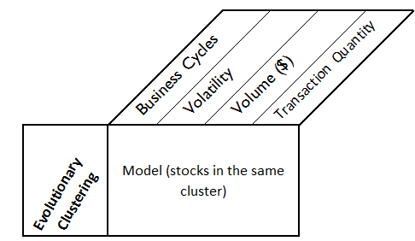
Evolutionary Clustering + Features

